Slide 1


Status of implementation of e-agriculture in Europe, including Western Balkans
Mihaly Csoto, FAO Consultant / National University of Public Service (NUPS) research fellow, Hungary
High Level Forum on e-agriculture “2gether 4 Strong Digital Agriculture”
18-20 April 2018, Sofia, Bulgaria

Slide 2

Context
High Level Forum on e-agriculture - “2gether 4 Strong Digital Agriculture”

Slide 3
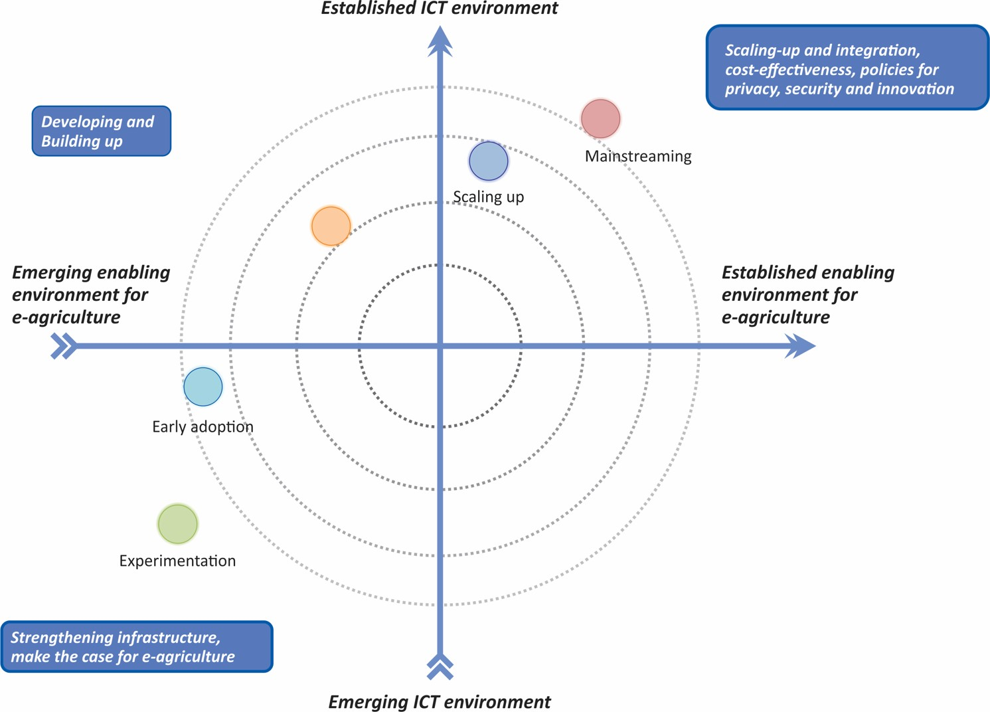
The environment of e-agriculture development
High Level Forum on e-agriculture - “2gether 4 Strong Digital Agriculture”

Slide 4
Recent activities in Europe and Central Asia
Regional Capacity Development Workshops on National e-Agriculture Strategies in Europe in 2015 and 2016 in Hungary
Activities based around the workshops:
- pre-workshop questionnaire
- experience and feedback of participants
- desk research on national strategies and policy background
- gathering of best practices and lessons learned
- region in the numbers: data collection on main agricultural and information society characteristics of the region to provide the context for future e-agriculture strategy development
High Level Forum on e-agriculture - “2gether 4 Strong Digital Agriculture”

Slide 5


Slide 6
Conclusions of earlier work
The state and implementation of e-Agriculture in Central-Eastern Europe and Central Asia varies from country-to-country.
The status of implementation and the level of ICT-development need to be continuously evaluated.
Existing data have to be collected, regrouped, edited, structured and combined in a way that it can serve specific goals in terms of e-agriculture development. Considering new ways of data/information collection.
„If you cannot measure it, you cannot manage it?„
High Level Forum on e-agriculture - “2gether 4 Strong Digital Agriculture”

Slide 7
Review of data sources to update e-agriculture status in the region
Data needs: Reliable, high quality, relevant, regularly updated (annual or biannual) and possibly covering every country in the region
Areas of data collection: ICT access and use (rural aspects, where available), basic economic data, importance and characteristics the agricultural sector, government performance especially relating to ICT policy and/or agriculture
ITU World Telecommunications Indicator Database, UN eGovernment Survey, World Bank World Governance Indicators, World Economic Forum Executive Opinion Survey
No specific, comprehensive e-agriculture-related datasets are available at the moment!
High Level Forum on e-agriculture - “2gether 4 Strong Digital Agriculture”
Notes:
ICT in Agriculture – State of art in Central Eastern Europe

Slide 8
Constructing an e-Agriculture Readiness Index (eARI)?
ICT environment | Indicators | Weight
1 | Percentage of internet users (ITU) | 0,2
2 | Percentage of the population covered by at least a 3G mobile network (ITU) | 0,2
3 | Percentage of the population covered by at least LTE/WiMAX mobile network (ITU) | 0,2
4 | Active mobile-broadband subscriptions per 100 inhabitants (ITU) | 0,2
5 | Estimated proportion of households with Internet access at home (ITU) | 0,2
Enabling environment for e-government | Indicator | Weight
1 | Availability of latest technologies, Government success in ICT promotion, ICT use and government efficiency, Importance of ICTs to government vision, Laws relating to ICTs (Executive Opinion Survey, WEF) | 0,33
2 | Online service index (UN E-Government Survey) | 0,33
3 | Government Effectiveness (World Bank WGI) | 0,33
Main challenge is to summarize complex or multi-dimensional issues in a simple manner: theoretical framework; wise selection of indicators; propper methodology to aggregate data
High Level Forum on e-agriculture - “2gether 4 Strong Digital Agriculture”
Notes:
the quality of policy formulation and implementation

Slide 9
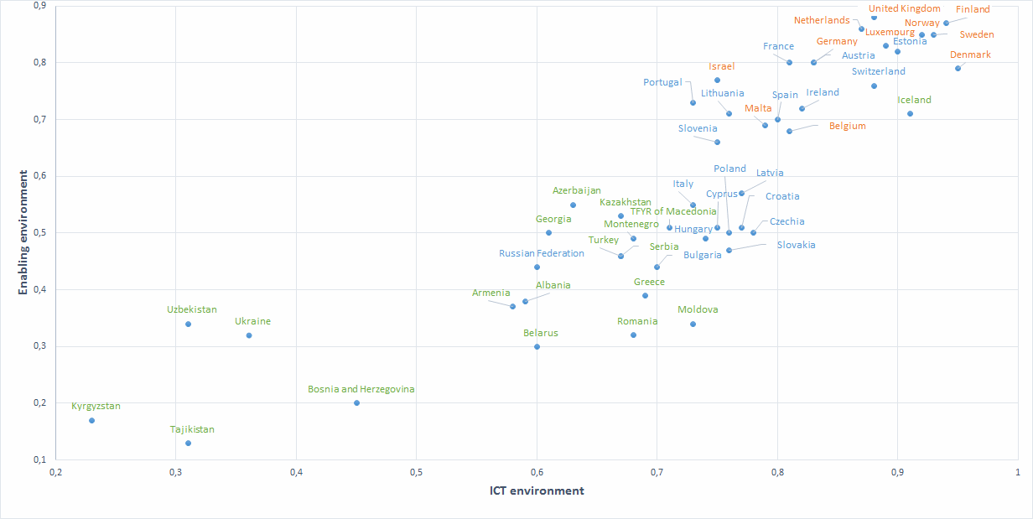
Agriculture, value added (% of GDP)
5 or above
between 2,5-5
below 2

Slide 10
 | ICT environment rank | Enabling Environment 1 (Executive opinion survey, WEF) | Enabling Environment 2 (Online service index, UN) | Enabling Environment 3 (Gov. Effectivness, WB) | Enabling environment rank | eAri rank
Finland | 2 | 6 | 2 | 4 | 2 | 1
Sweden | 3 | 5 | 8 | 6 | 4 | 2
Norway | 4 | 3 | 15 | 3 | 5 | 3
United Kingdom | 8 | 4 | 1 | 9 | 1 | 4
Denmark | 1 | 14 | 17 | 2 | 11 | 5
Netherlands | 10 | 9 | 4 | 5 | 3 | 6
Luxemburg | 7 | 1 | 23 | 8 | 6 | 7
Estonia | 6 | 2 | 7 | 17 | 7 | 8
Switzerland | 9 | 11 | 35 | 1 | 13 | 9
Austria | 12 | 16 | 5 | 10 | 8 | 10
Germany | 11 | 15 | 12 | 7 | 8 | 10
Iceland | 5 | 7 | 31 | 11 | 16 | 12
France | 15 | 17 | 2 | 11 | 10 | 13
Ireland | 13 | 12 | 22 | 13 | 15 | 14
Israel | 26 | 13 | 10 | 13 | 12 | 15
Spain | 16 | 24 | 5 | 17 | 18 | 16
Belgium | 14 | 21 | 24 | 15 | 20 | 17
Malta | 17 | 18 | 16 | 24 | 19 | 18
Lithuania | 21 | 19 | 13 | 20 | 17 | 19
Portugal | 29 | 8 | 19 | 16 | 14 | 20
Slovenia | 25 | 27 | 11 | 17 | 21 | 21
Latvia | 19 | 23 | 32 | 22 | 22 | 22
Croatia | 20 | 38 | 19 | 29 | 26 | 23
Italy | 28 | 40 | 9 | 27 | 23 | 24
Czechia | 18 | 30 | 43 | 21 | 30 | 25
Poland | 23 | 42 | 25 | 26 | 29 | 26
Slovakia | 22 | 29 | 46 | 25 | 34 | 28
Hungary | 27 | 34 | 30 | 30 | 33 | 29
TFYR of Macedonia | 31 | 20 | 32 | 34 | 27 | 30
Montenegro | 34 | 28 | 27 | 33 | 32 | 33
Bulgaria | 32 | 33 | 40 | 31 | 37 | 34
Serbia | 37 | 47 | 14 | 34 | 35 | 35
Turkey | 36 | 25 | 34 | 36 | 35 | 35
Greece | 33 | 45 | 39 | 32 | 39 | 38
Moldova | 30 | 37 | 36 | 47 | 43 | 39
Russian Federation | 42 | 35 | 21 | 42 | 38 | 40
Romania | 35 | 41 | 44 | 41 | 44 | 41
Albania | 43 | 44 | 36 | 37 | 40 | 42
Ukraine | 46 | 43 | 38 | 45 | 45 | 45
Bosnia and Herzegovina | 45 | 49 | 45 | 43 | 47 | 47

Slide 11
Thank you!
High Level Forum on e-agriculture - “2gether 4 Strong Digital Agriculture”

